Slide 1

presentation
Project: Implement and compare recent prefetching schemes
Member: Yehan Wang Qike Ying Can Li

Slide 2


R
MENU
01
Introduction for prefetching
U
02
Algorithms
T
03
Definition
G
04
Performance
E
05
Code analysis
06
Result
R
07
Conclusion
S

Slide 3
Introduction
R
R
S
T
E
U
G
Software prefetching
Hardware prefetching
Mechanism
Software and hardware combination prefetching
Aim
improve access hit rate
Sequential prefetching
Thoughts
Non-sequential prefetching

Slide 4
Definition for Prefetching
R
R
T
E
S
U
G
Access
cache
Next level cache
miss
Prefetch block
Next-line
prefetch
Long-line

Slide 5
Code Analysis
R
R
T
E
S
U
G
Basic thought
First of all, we add a parameter in the cache_create function called prefetch_blk_count which indicates how many blocks the program will prefetch in cache.c. Then we create the function cache_prefetch_block which is similar with cache_access based on cache miss. When a miss occurs, the program will prefetch more instructions or data instead of one without non-prefetching.

Slide 6
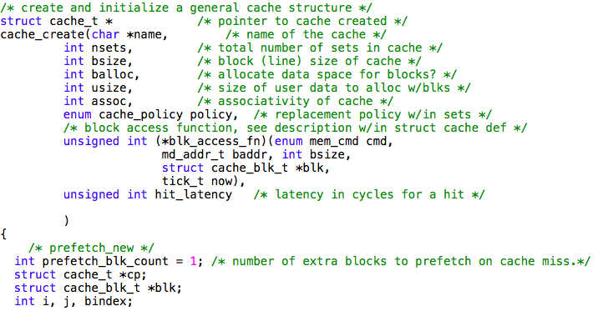

Slide 7
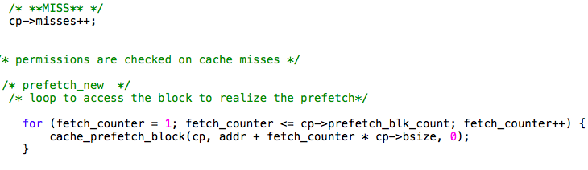

Slide 8
Next-line prefetch
R
R
T
E
S
U
G
This implement can be changed into 2 or more

Slide 9
Long-line prefetch
R
R
T
E
S
U
G
(here we prefetch 4 blocks for example)

Slide 10
Performance Measures
R
R
T
E
S
U
G
CPI
dl1-miss rate(data level 1 cache miss rate)
il1-miss rate(instruction level 1 cache miss rate)

Slide 11
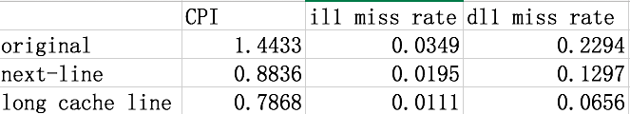
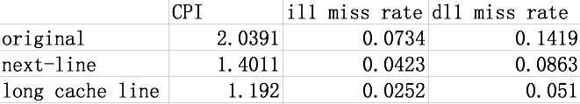
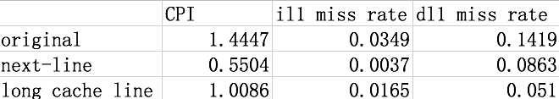
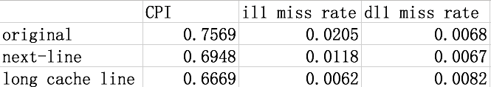
gcc
anagram
compress95
go

Slide 12
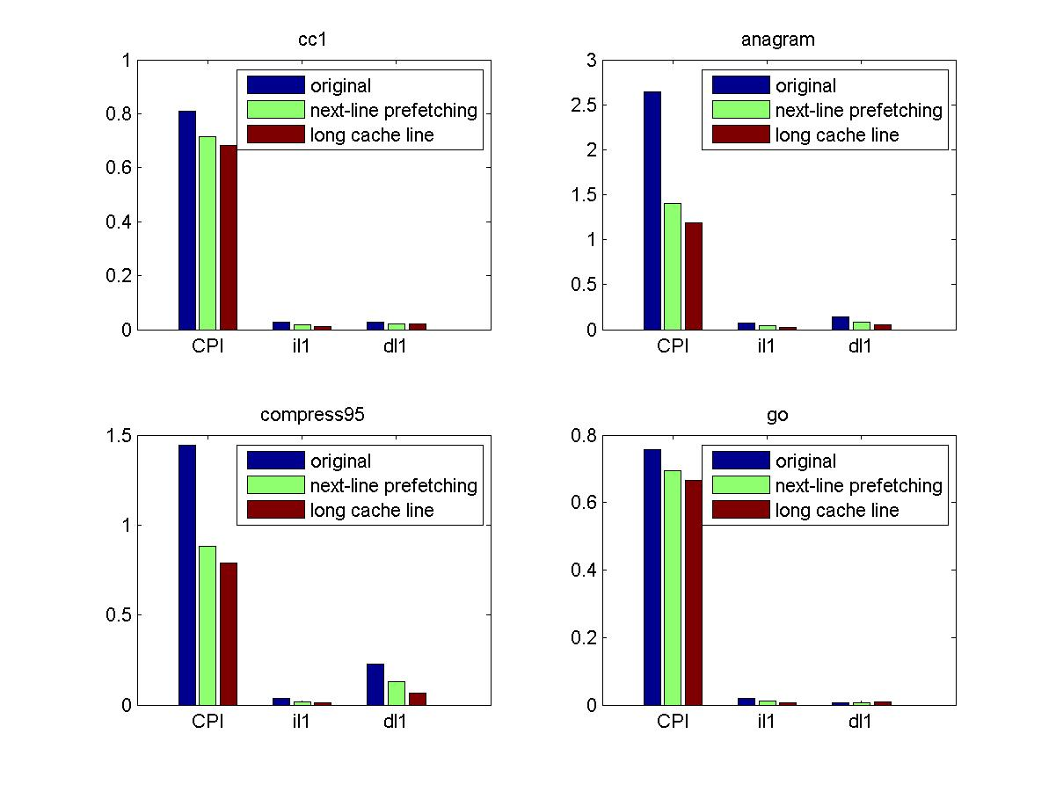
result

Slide 13
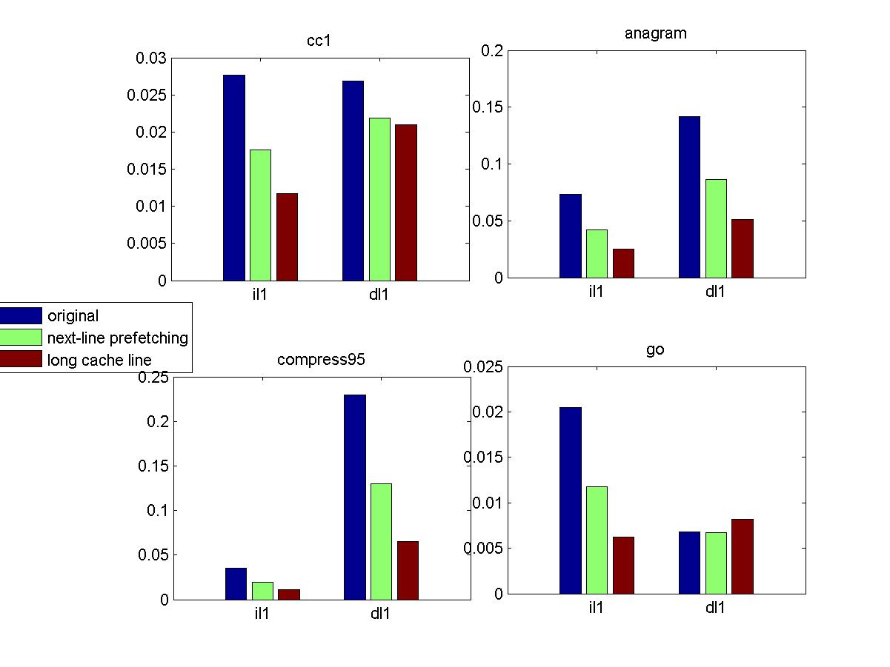

Slide 14
Conclusion
R
R
T
E
S
U
G
Prefetching can greatly improve the performance of superscalar processor. All of our implementation have supported this result. We can see from figure 5, the CPI has decreased a lot after prefetching. il1 and dl1 miss rate also decreases. Except for compress95, other three compilers receive better result in long cache line compared with next line strategy. However, the instruction numbers of anagram and compress95 is a little less such that the result is not so persuasive compared with 2stone and gcc. Also, we experiment to set the value of prefetch numbers into 8 or more, finding that the CPI just increase just a little but it will take more times of space of cache and improve the danger of cache traffic. So prefetching also exists bottle neck and we should make a balance when we use prefetch for optimization

Slide 15
Thankyou
Member: Yehan Wang Qike Ying Can Li

